Slide 1
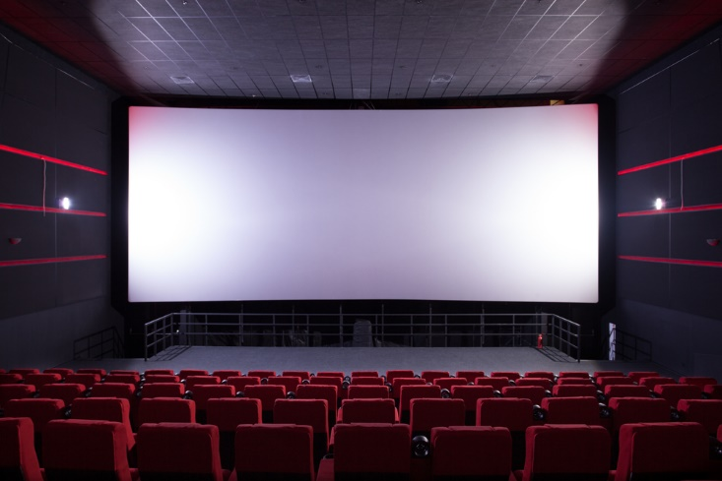
Cinema Website

Slide 2
Personal Information
Name: George Eshak Shawky.
Section :IS(2).
Phone no. 0122 847 5071.
Email: georgeeshak@hotmial.com
GitHub: https://github.com/GeorgeEshak/Cinema-Website
GPA : 2.25

Slide 3
Technology will use
Front end :
HTML
CSS
JavaScript
Bootstrap to make my website responsive.
Database:
MySQL
Back end :
PHP

Slide 4
Suggestion to improve my website
In signup:
Get user age and show movies which allow to watch associated with his ages.
In booking section :
Make user choosing the seats in hall of cinema.
If the transaction of payment valid , user will able to print the ticket.

Slide 5
Description
Will be easy to use for all ages.
This website include sign in , view of movies and times ,book tickets and payment method.
First client will enter some information about him (username, mail and password)

Slide 6
What is purpose of Cinema website ?
It make registration more easier from your home and your work.
It provide to know what movies will show and times for each movie.
It provide to pay online by credit card.

Slide 7
Platform
Xampp
Apache server
MySQL Workbench
Komodo edit
Windows

